Slide 1

Project Three : Statistics Preview Card

Slide 2
What you will Learn From this Project
Extracting different elements from the design
Converting the extracted elements into HTML Code
Flex
Manipulating Images in (CSS and HTML)
Responsive design

Slide 3
Extracting elements from the design
Body
Card-Container

Slide 4
Extracting elements from the design
Card-content
Card-image

Slide 5
Extracting elements from the design
Body
Body
Card
Card-content
Card-heading
Card-text
Card-stats
3 stats
Card-image
image
Card-Container

Slide 6
Lets transform our elements into code

Slide 7
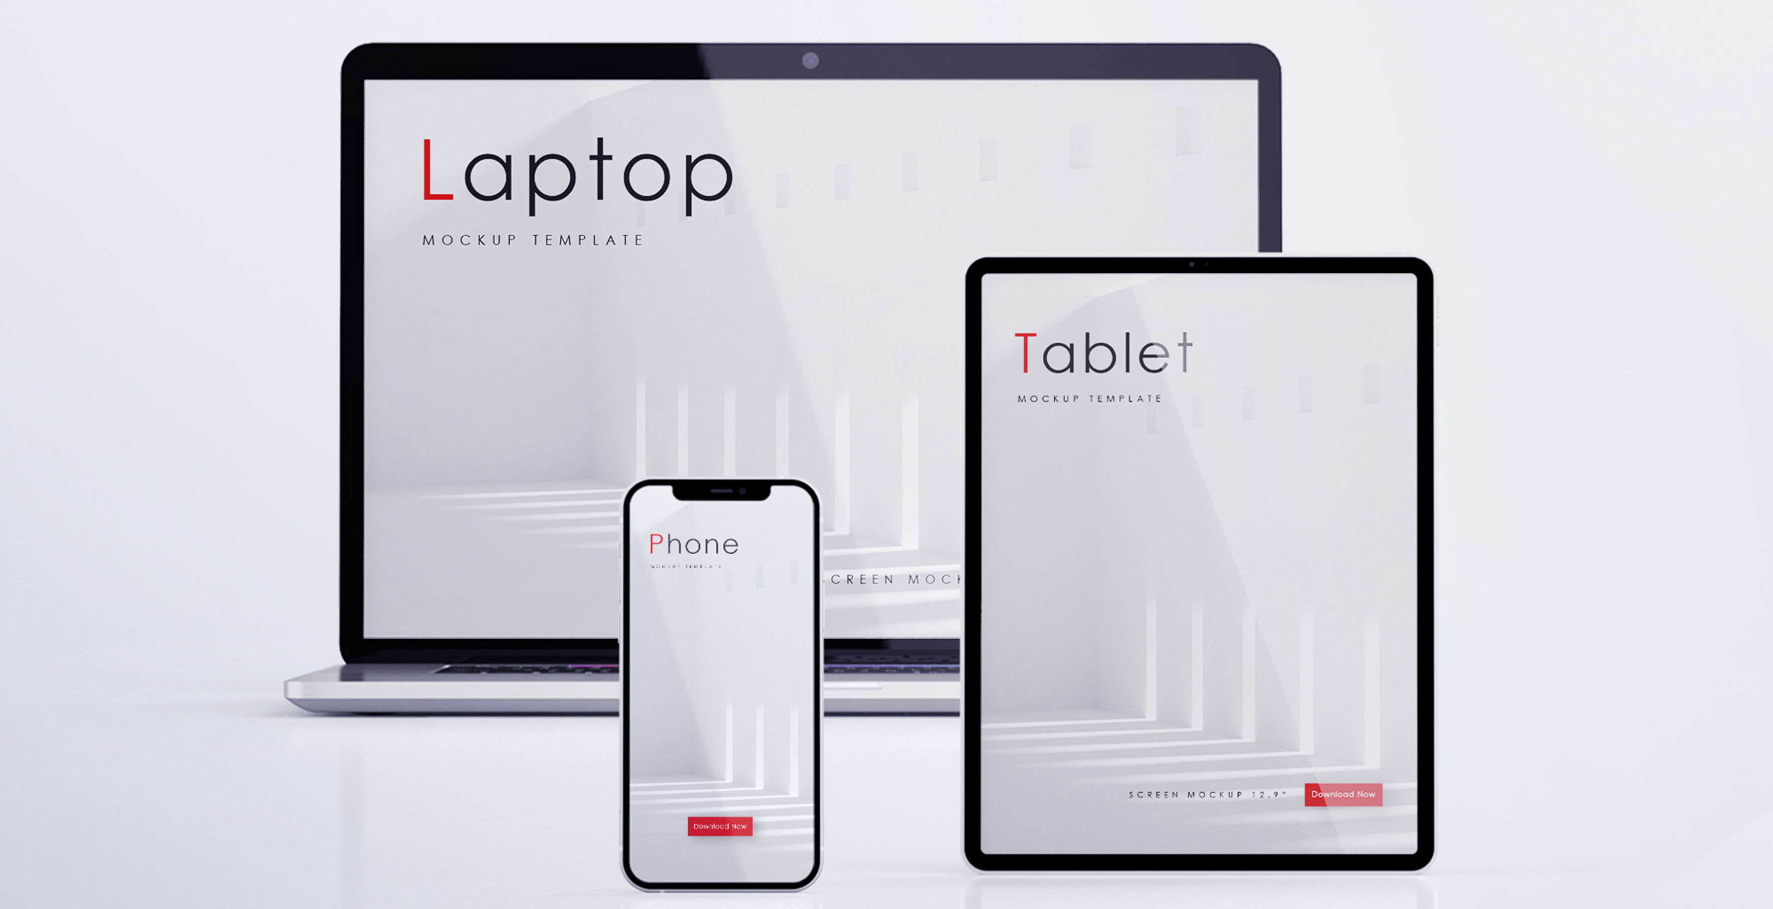
Responsive design
Having a web page that looks good on all devices (laptop,tablet,phone)

Slide 8

Responsive design

Slide 9

Responsive design
Tablet and phone preview
Desktop and laptop preview

Slide 10
Responsive design
Tablet and phone preview
Desktop and laptop preview
By default we design for a desktop
So we need to change our code so that our card looks good also on the phone

Slide 11
How do we plan for Responsive design
Trick: look at a web section layout in terms of columns. Then decide how many columns should be on the desktop and phone eg 2 cols on desktop and 1 col on the phone

Slide 12
Tablet and phone preview
How do we plan for Responsive design
Desktop and laptop preview
w-100%
w-50%
w-50%
w-100%
2 columns
1 column

Slide 13
How do we achieve Responsive design
By using Media Queries
Syntax
@media screen and (max-width:690px){
code here…..
}

